Slide 1


Real-Time Health Care Monitoring System (ONLINE)
Archita Singh (Team Leader)
Devanshi Teotia
Aditya Bhatt
Bhaskar Raj

Slide 2

Objective
1
Real-Time Data
2
Early Detection
Collect and analyze patient vital signs in real-time, providing instant insights for clinicians.
Identify potential health issues early, enabling proactive interventions and reducing complications.
3
Remote Monitoring
4
Improved Outcomes
Enable continuous patient monitoring from remote locations, improving accessibility and convenience.
Optimize care plans and reduce hospital readmissions through timely interventions and personalized treatment.

Slide 3

Problem Statement
Limited Accessibility
Data Delays
Resource Constraints
Traditional monitoring methods often require patients to visit hospitals or clinics for checkups.
Manual data collection and analysis can lead to delays in identifying critical health changes.
Hospitals and clinics may face staffing shortages and limited resources, impacting the quality of care.

Slide 4
start
User
Input Data / Book’s Appointment's
Check Symptoms and
Appoints Doctor
normal medicines provided
Cure happens
Examined
by doctor
login
Scheduled for next appointment
Further check up
sudden death
Diagnosis
Referred to admit
end
Discharged
Good test
reports
Not good
test reports
Proper medicines
Start
Further treatment

Slide 5

Technical Stacks
Technology
Purpose
Java
Backend development, data processing, and application logic
Spring Boot
Framework for building RESTful APIs and microservices
MySQL
Relational database for storing patient data and system configurations
Html
To create the structure of web pages
React
JavaScript library for building interactive and responsive user interfaces

Slide 6
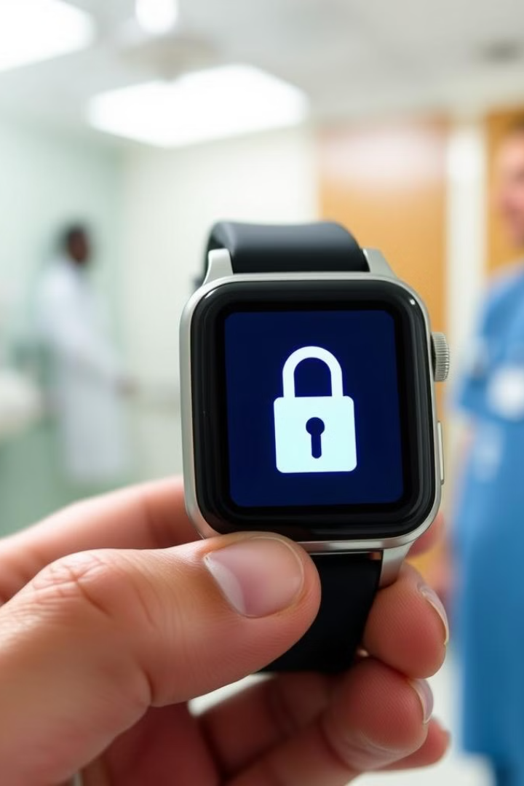



Privacy and Security Considerations
Data Encryption
Robust encryption protocols ensure the confidentiality of sensitive health data during collection, transmission, and storage.
Access Control
Strict access controls and user authentication measures protect against unauthorized access to personal health information.
Regulatory Compliance
Health monitoring systems must adhere to relevant data privacy and security regulations, such as HIPAA, to ensure user trust.

Slide 7

Thank You

